Slide 1
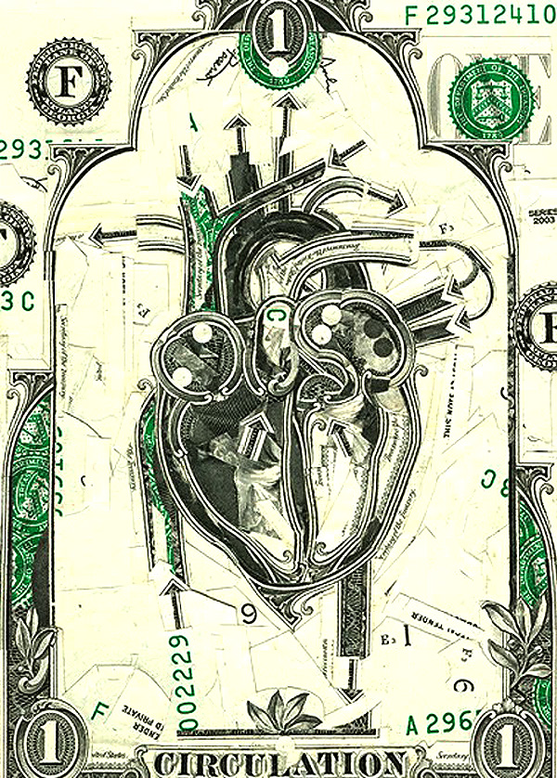


Slide 2
OVERVIEW
Transportation– how do we move things throughout our bodies?
Heart Anatomy – what are the important structures of their heart, and how do they play a role in transportation of blood?
Blood Flow – how does the unique anatomy of the heart relate to how oxygenated and deoxygenated blood flows through the cardiovascular system?

Slide 3
INTRODUCTION
A closed system of the heart and blood vessels
  The heart pumps blood
  Blood vessels allow blood to circulate to all parts of the body
FUNCTION: Transport oxygen, nutrients, cell wastes, hormones to and from cells

Slide 4

INTRODUCTION
The heart keeps the blood in motion
Heart Facts
  Beats about 100,000 times per day
  Pumps about 1.5 millions gallons of blood per year
  Pumps between 5 and 30 liters of blood per minute

Slide 5
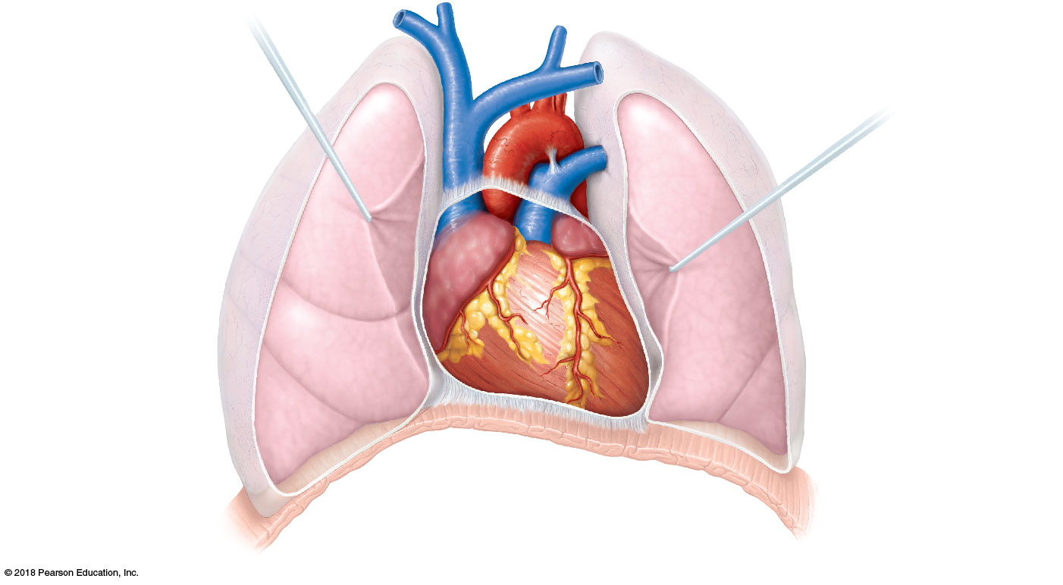
HEART ANATOMY
Superior
vena cava
Aorta
BASE of
heart
Pulmonary
trunk
Left lung
APEX of
heart
Diaphragm

Slide 6
HEART ANATOMY
Orientation
  Apex is the most inferior portion of the heart and is pointed toward left side of the body
  Base sits on the superior portion of the heart
  Left of midline, slightly rotated, and at an oblique angle
VS

Slide 7
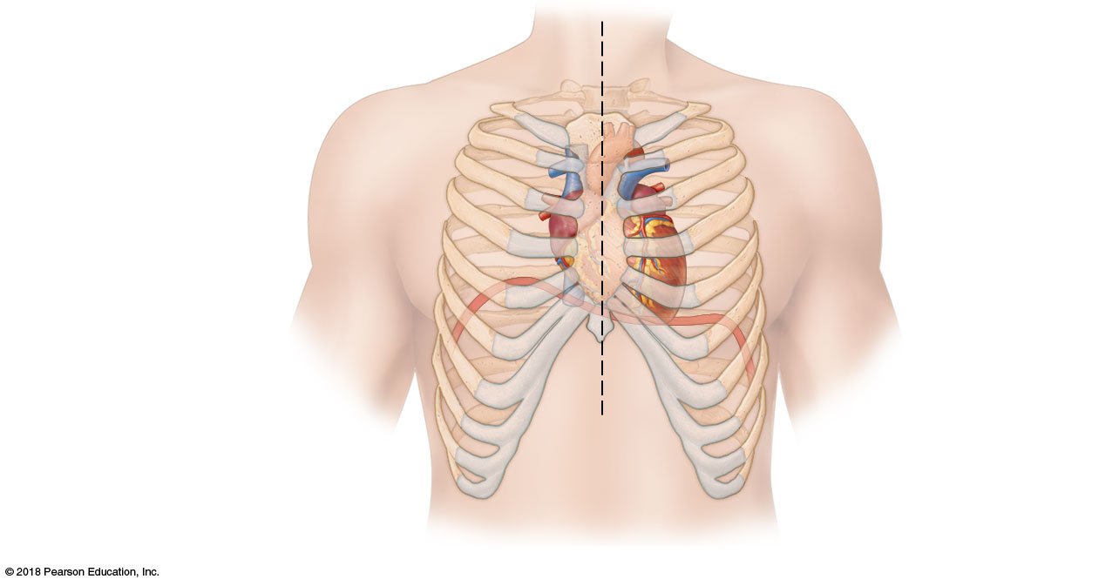
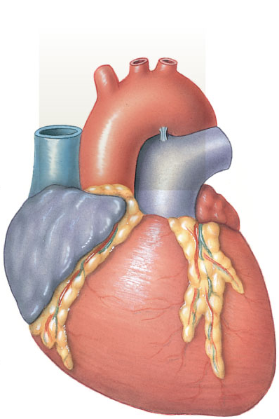
HEART ANATOMY
Sternum

Slide 8
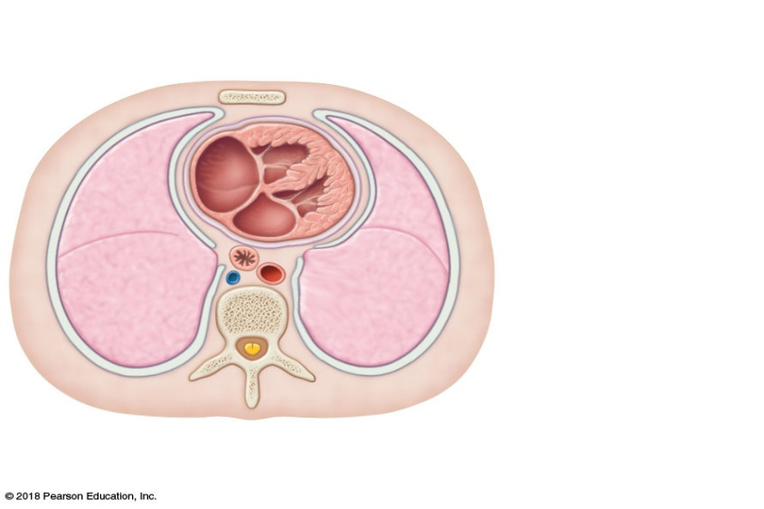
HEART ANATOMY
Pericardium = Membrane lining the heart
  Reduces friction from constant beating of the heart
2 Layers of the Pericardial Membrane
  Visceral pericardium
    The “inside” layer
    Close to the heart
  Parietal pericardium
    The “outside” layer
    Close to the lungs and the thoracic wall
Heart
Right lung

Slide 9
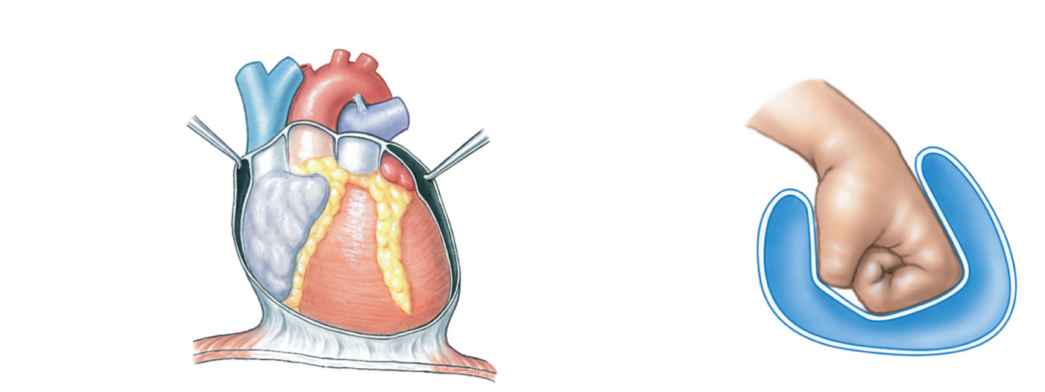
HEART ANATOMY
Air space
(corresponds
to pericardial
cavity)
Parietal
pericardium
Pericardial
cavity
Visceral
pericardium
Balloon
Notes:
9

Slide 10
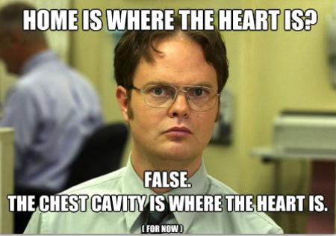
HEART ANATOMY
3 Layers of the heart
  Epicardium
    Outermost layer
    AKA the visceral layer of the pericardium
  Myocardium
    Middle layer
    Cardiac muscle
    Thickest of the 3 layers
  Endocardium
    Inner layer that lines the heart chambers
    Endothelium = simple squamous epithelium

Slide 11
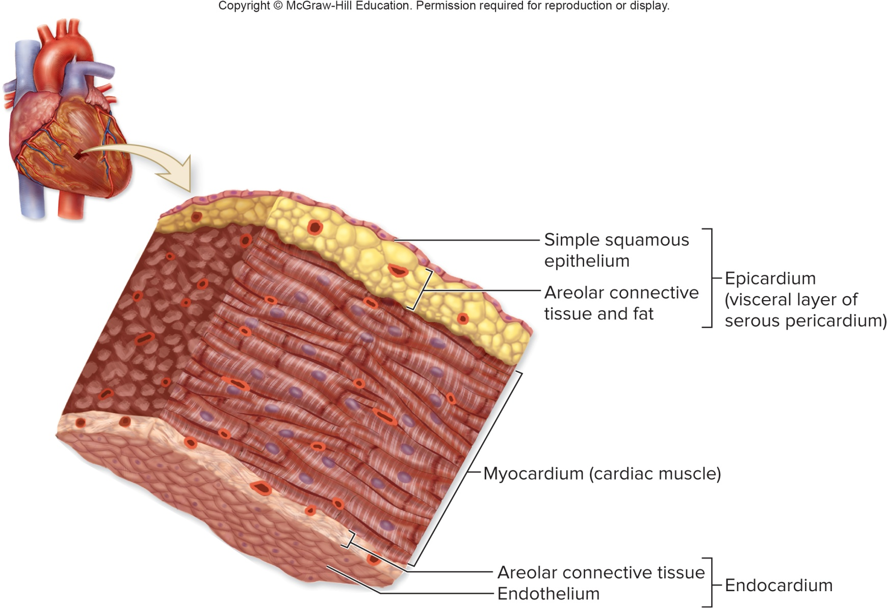
HEART ANATOMY

Slide 12
HEART ANATOMY
4 Chambers of the heart
  2 Atria (right and left)
    Receive blood
    During contraction, blood is propelled into the ventricles
  2 Ventricles (right and left)
    Discharge blood
    During contraction, blood is propelled out of the heart and into circulation
    The left ventricle is the most muscular chamber of the entire heart

Slide 13
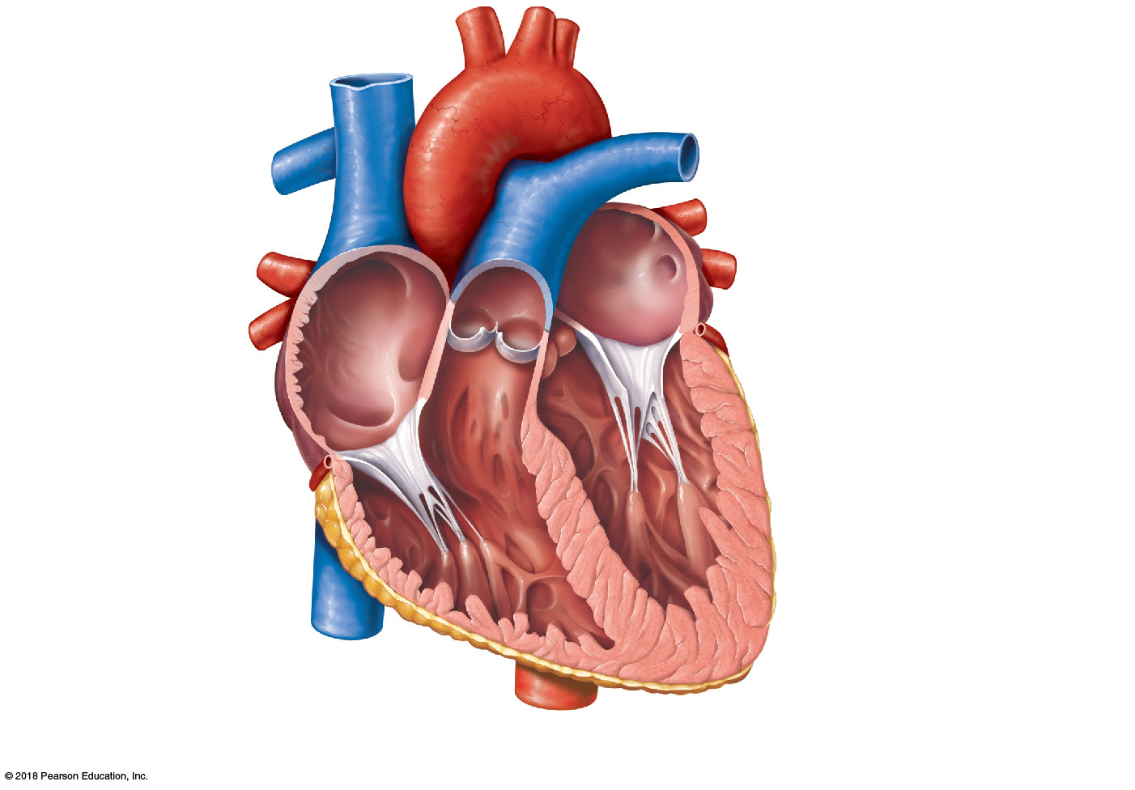
HEART ANATOMY
Left atrium
Right atrium
Left ventricle
Right ventricle

Slide 14
HEART ANATOMY
External Landmarks
  Auricles
    Roof-like projections on top of the atria
  Interventricular sulci
    One sulcus is anterior, one sulcus is posterior
    Separate the two ventricles longitudinally
  Coronary sulcus
    Separates the atria and ventricles horizontally

Slide 15
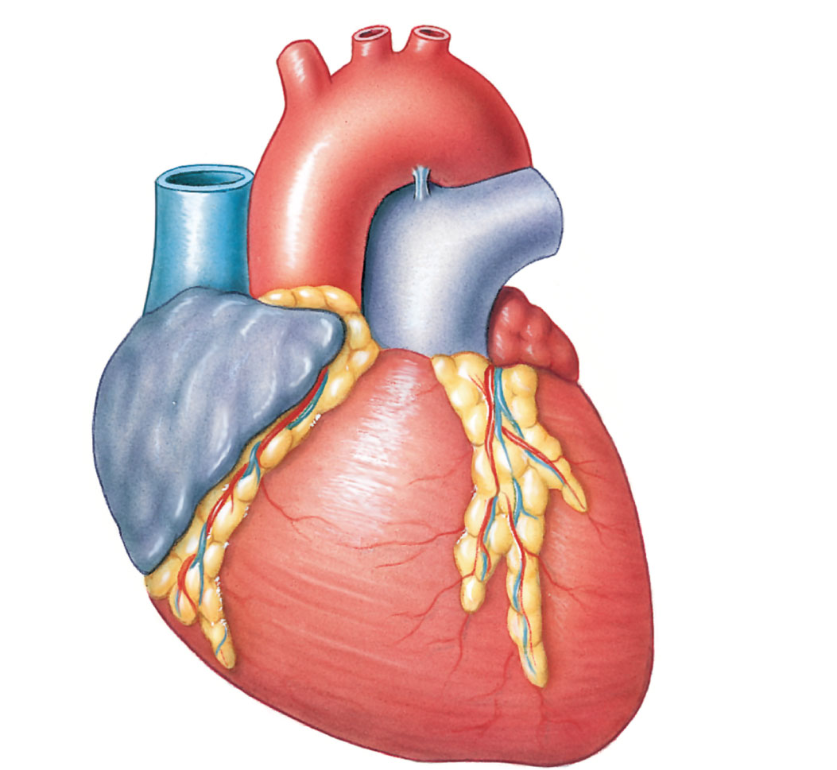
HEART ANATOMY
Auricle of
RIGHT ATRIUM
Auricle of
LEFT ATRIUM
RIGHT
ATRIUM
Fat in ANTERIOR
INTERVENTRICULAR SULCUS
RIGHT
VENTRICLE
Fat in
CORONARY SULCUS
LEFT
VENTRICLE
Notes:
15

Slide 16
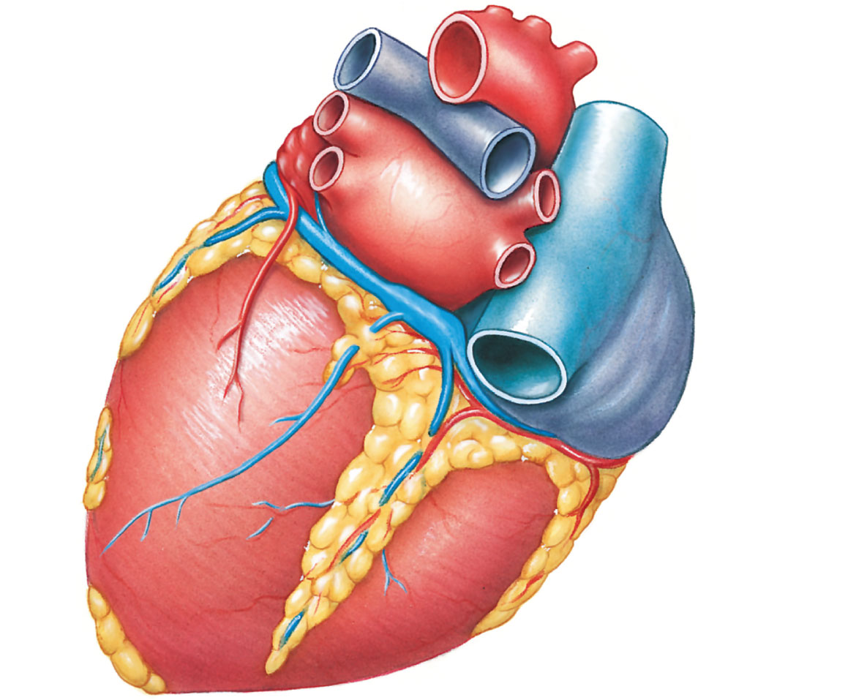
HEART ANATOMY
Auricle of
LEFT ATRIUM
LEFT
ATRIUM
Fat in
CORONARY SULCUS
RIGHT
ATRIUM
LEFT
VENTRICLE
RIGHT
VENTRICLE
Fat in POSTERIOR
INTERVENTRICULAR SULCUS
Notes:
16

Slide 17
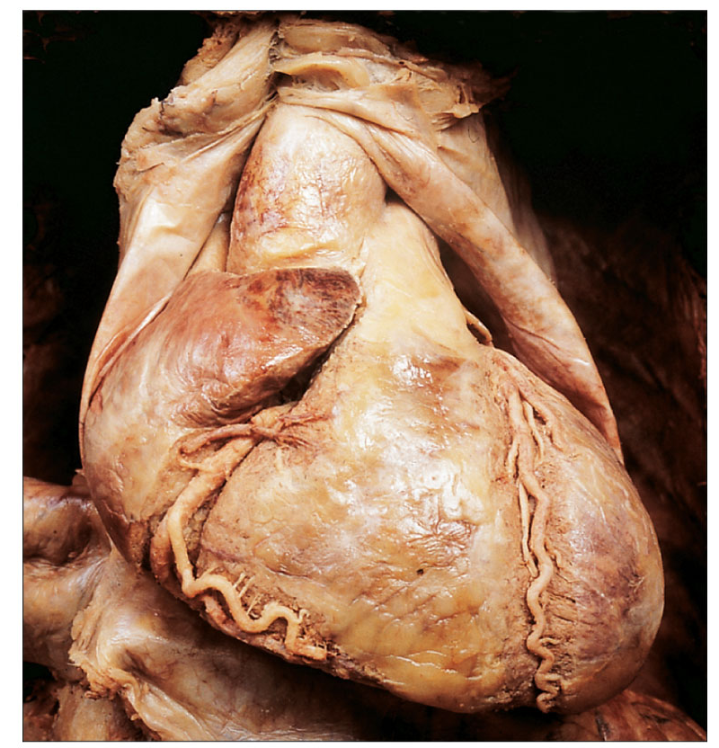
HEART ANATOMY
Auricle of
RIGHT ATRIUM
Auricle of
LEFT ATRIUM
RIGHT
ATRIUM
RIGHT
VENTRICLE
LEFT
VENTRICLE
Coronary sulcus
Anterior
interventricular
sulcus
Notes:
17

Slide 18
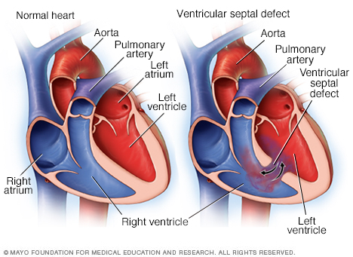
HEART ANATOMY
“Holes in the heart” are abnormal connections between chambers
  Connections between right and left atria
  Connections between right and left ventricles

Slide 19

HEART ANATOMY
  Valves keep blood flowing in one direction
4 Valves of the heart
  2 Atrioventricular or AV valves (right and left)
    ONLY allow blood flow from atria → ventricles
    Also known as the tricuspid and mitral valves
  2 Semilunar valves (pulmonary and aortic)
    ONLY allow blood flow from ventricles → circulation

Slide 20
HEART ANATOMY
Pulmonary valve
Left AV valve
Aortic valve
Right AV valve

Slide 21
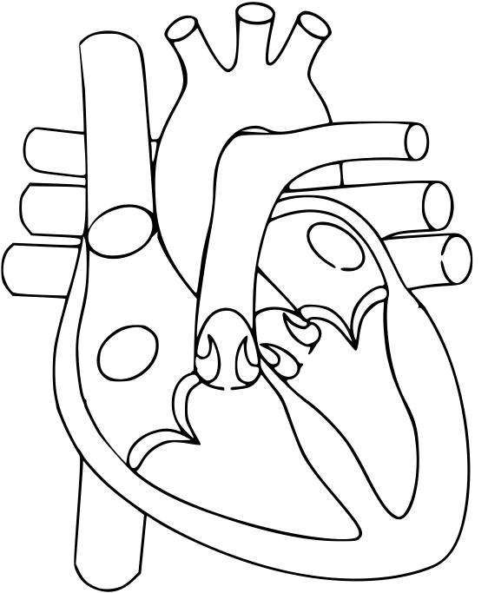
Color and label (using study notes or slides):
Deoxygenated = Blue
Oxygenated = Red
Label all chambers
Label all great vessels
Starting with the vena cavae as #1, indicate the order that blood flows through the heart

Slide 22
HEART ANATOMY
Right Heart → Lungs → Left Heart
Heart = Double Pump
  Right side sends deoxygenated blood to the lungs
    Pulmonary circuit
  Left side sends oxygenated blood to the body
    Systemic circuit

Slide 23
HEART ANATOMY
Blood Vessels
  Arteries carry blood away from the heart
  Veins carry blood toward the heart
  Oxygenation does NOT matter!
Pulmonary Circuit Vessels – RIGHT
  Superior Vena Cava
  Inferior Vena Cava
  Pulmonary Trunk
  Pulmonary Arteries
Systemic Circuit Vessels – LEFT
  Pulmonary veins
  Aorta

Slide 24
HEART ANATOMY
Superior vena cava
Aorta
Left pulmonary artery
Right pulmonary artery
Left pulmonary veins
Pulmonary Trunk
Inferior vena cava

Slide 25
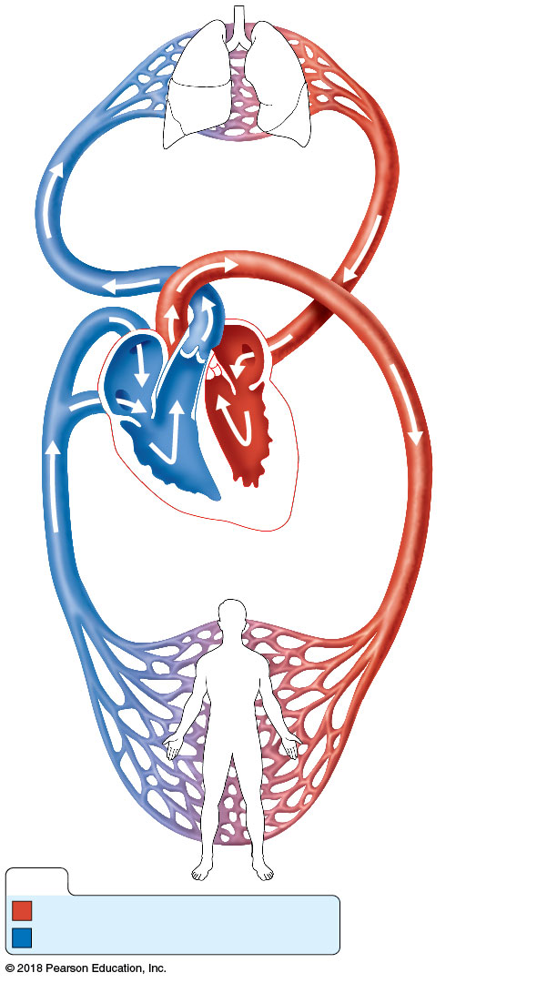
Pulmonary Circuit
Pulmonary
Circuit
Organs → Heart
Left
atrium
Systemic
Circuit
Heart → Organs
Left
ventricle
Right
atrium
Heart
Right
ventricle
Systemic Circuit
KEY:
Oxygen-rich, CO₂-poor blood
Oxygen-poor, CO₂-rich blood

Slide 26
BLOOD FLOW
Step 1 = Get oxygen (O₂) in the blood
Right Atrium
  Receives deoxygenated blood from the body via the superior vena cava and the inferior vena cava
Right AV valve
  Blood leaves the right atrium and enters the right ventricle by passing through the right AV valve
Right Ventricle
  Receives deoxygenated blood from the right atrium
  Pumps blood to the lungs
Pulmonary semilunar valve
  Blood leaves the right ventricle by passing through the pulmonary semilunar valve

Slide 27
BLOOD FLOW
Superior vena cava
Right atrium
Pulmonary valve
Right AV valve
Right ventricle
Inferior vena cava

Slide 28
BLOOD FLOW
Pulmonary Trunk
  First location blood enters as it travels to the lungs
  Large artery
Pulmonary Arteries
  Divisions of the pulmonary trunk
  Carry blood to the right and left lungs
Lungs
  Blood is oxygenated
  Pulmonary circuit ENDS

Slide 29
BLOOD FLOW
Left pulmonary artery
Right pulmonary artery
LEFT LUNG
RIGHT LUNG
Pulmonary Trunk

Slide 30
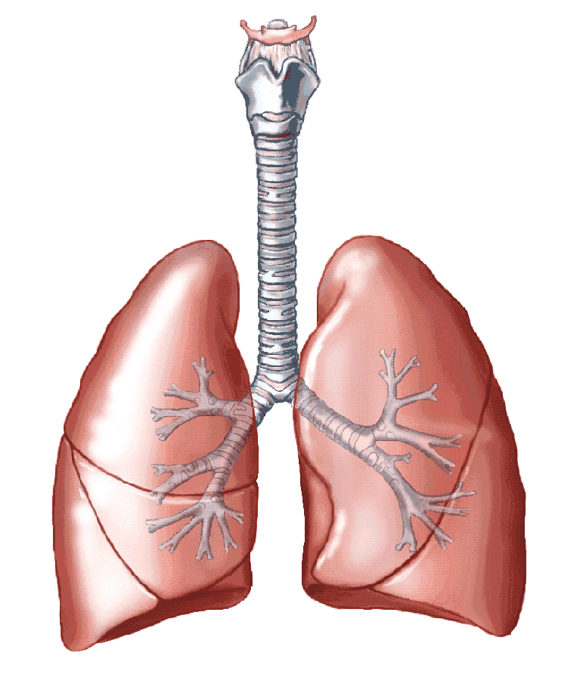
BLOOD FLOW
Pulmonary Circuit Summary
  Vena cavae → Right Atrium
  Right Atrium → Right AV valve → Right Ventricle
  Right Ventricle → Pulmonary Valve → Pulmonary Trunk
  Pulmonary Trunk → Right and Left Pulmonary Arteries
  Pulmonary Arteries → LUNGS

Slide 31
BLOOD FLOW
Right = Left
  Veins take blood to the atria
  Atria pump blood across an AV valve into a ventricle
  Ventricle pumps blood through a semilunar valve and into a large artery
  The large artery takes blood away from the heart

Slide 32
BLOOD FLOW
Step 2 = Get oxygen everywhere
Left Atrium
  Receives oxygenated blood from the lungs via the left and right pulmonary veins
Left AV valve
  Blood leaves the left atrium and enters the left ventricle by passing through the left AV valve
Left Ventricle
  Receives oxygenated blood from the left atrium
  Pumps blood to the body
Aortic semilunar valve
  Blood leaves the left ventricle and enters the aorta by passing through the aortic semilunar valve
Aorta
  The aorta and its branches carry blood travels throughout the body

Slide 33
BLOOD FLOW
Aorta
Left atrium
RIGHT LUNG
Left pulmonary veins
LEFT LUNG
Right pulmonary
veins
Left AV valve
Aortic valve
Left ventricle
THE BODY

Slide 34
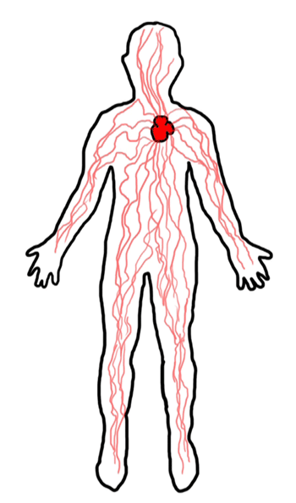
BLOOD FLOW
Systemic Circuit Summary
  Lungs → Left and Right Pulmonary Veins → Left Atrium
  Left Atrium → Left AV valve → Left Ventricle
  Left Ventricle → Aortic Valve → Aorta
  Aorta → BODY

Slide 35
BLOOD FLOW
Putting it all together
Deoxygenated blood from the body uses either the Superior Vena Cava or Inferior Vena Cava to enter the Right Atrium
The Right Atrium pumps blood across the Right AV Valve to the Right Ventricle
The Right Ventricle pumps blood through the Pulmonary Semilunar Valve to the Pulmonary Trunk
The Pulmonary Trunk splits into the Right Pulmonary Artery and Left Pulmonary Artery, which carry blood to the lungs to be oxygenated
The lungs oxygenate the blood
Oxygenated blood from the lungs uses the Pulmonary Veins to enter the Left Atrium
The Left Atrium pumps blood across the Left AV Valve to the Left Ventricle
The Left Ventricle pumps blood through the Aortic Semilunar Valve to the Aorta
The Aorta splits into the arteries of the body, which carry oxygenate blood to all cells

Slide 36
RIGHT – Pulmonary Circuit
Superior vena cava
Left pulmonary artery
Right pulmonary artery
LEFT LUNG
RIGHT LUNG
Right atrium
Pulmonary valve
Pulmonary Trunk
Right AV valve
Right ventricle
Inferior vena cava

Slide 37
LEFT – Systemic Circuit
Aorta
Left atrium
RIGHT LUNG
Left pulmonary veins
LEFT LUNG
Right pulmonary
veins
Left AV valve
Aortic valve
Left ventricle
THE BODY

Slide 38
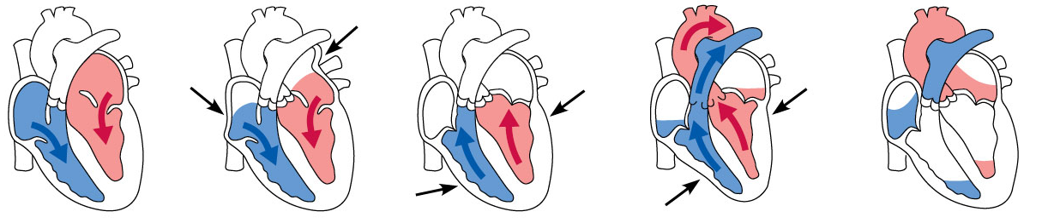
BLOOD FLOW
Right and Left sides beat simultaneously
  As the right atrium pumps blood to the right ventricle, the left atrium pumps blood to the left ventricle
  As the right ventricle pumps blood to the lungs, the left ventricle pumps blood to the body
  As the pulmonary trunk carries deoxygenated blood to the lungs, the aorta carries oxygenated blood to the body
A single heart beat moves blood through BOTH circuits

Slide 39
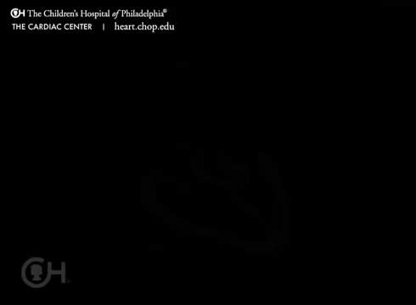
This video is also posted on Bb
Notes:
This video is also posted on BlackBoard under the Unit 4 Lessons tab.

Slide 40
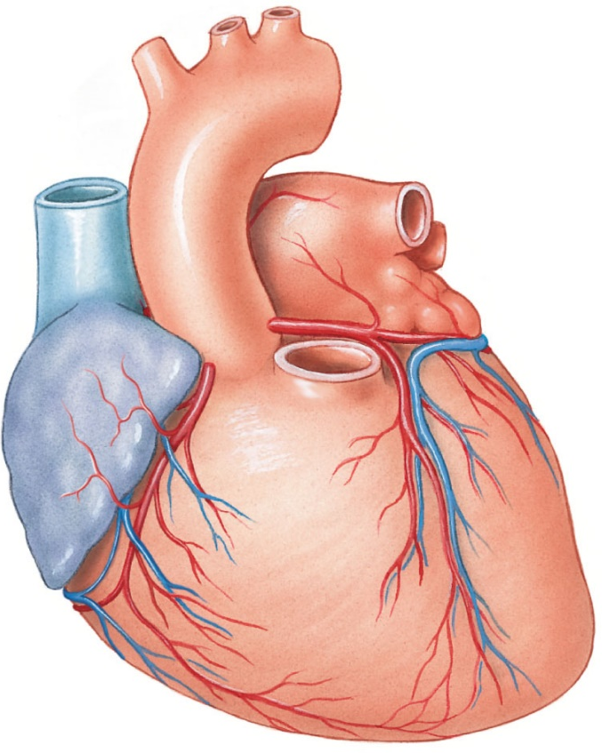
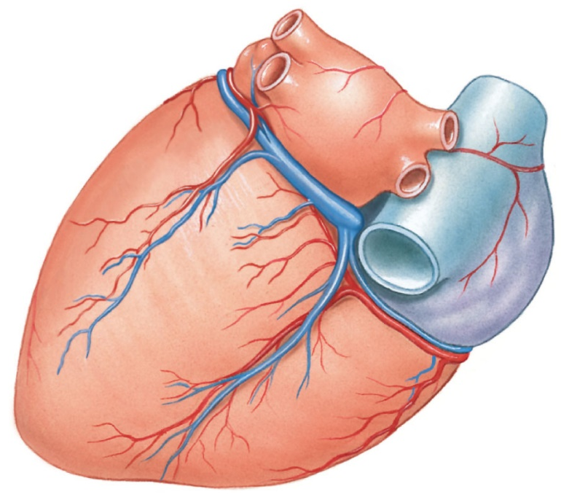
BLOOD FLOW
Coronary Arteries
  Supply oxygenated blood to the heart itself
    Come off the aorta near its base
    Provide maximally oxygenated blood at high pressure
Coronary
vessels

Slide 41
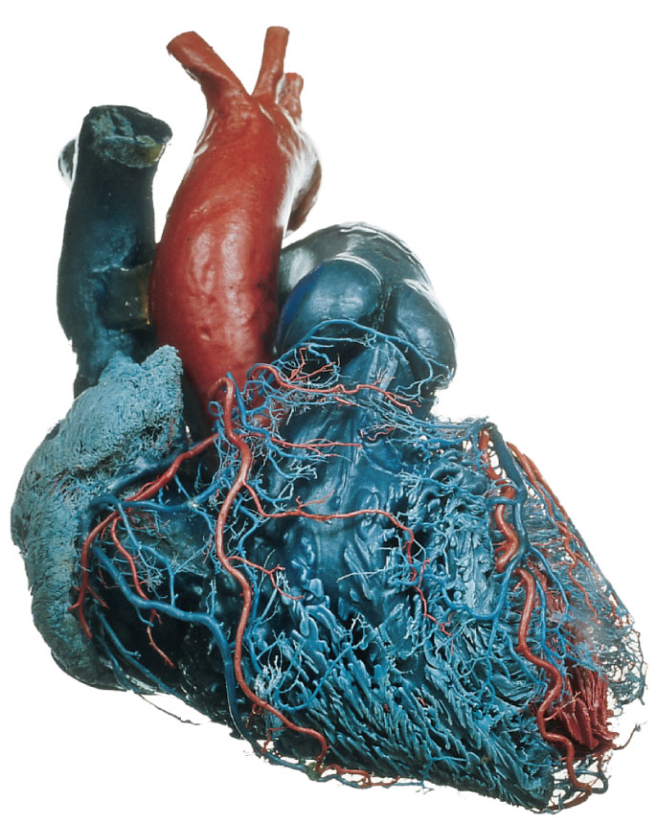
WHY DOES THIS MATTER?
Heart attacks are blocked coronary arteries
Notes:
41

Slide 42
THE HEARTBEAT
The heart generates blood pressure through alternating cycles of contraction and relaxation
Contraction + Relaxation = 1 heartbeat
  AKA The Cardiac Cycle
Blood Pressure:
  The force of the blood pushing against the inside walls of blood vessels
  Essential to circulate blood

Slide 43
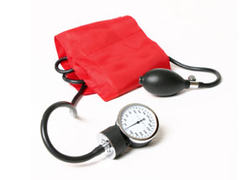
THE HEARTBEAT
Contraction is called systole
  Ventricles: ejecting blood into the pulmonary trunk and ascending aorta
  Atria: refilling with blood
  Pressure is high
Relaxation is called diastole
  Ventricles: refilling with blood
  Atria: ejecting blood into the ventricles
  Pressure is low

